Slide 1
Estate Planning:
TOOLS, TIPS,
TrICKS, AND TRAPS
Mark Reinhardt, Attorney
Rehberg Law Group, PLLC

Slide 2
Topics to be Covered
What is estate planning?
Control and Peace of Mind
Estate Planning is Strategic
What is the best “vehicle” to administer my estate?
Do Nothing or “Intestacy”
Titling
Community Property Agreements
Wills
Revocable Living Trusts
Have I properly planned for the beneficiaries of my estate?
Planning for Surviving Spouse
Planning for Children and Grandchildren
Is my planning out of date?

Slide 3
Estate Planning is ABOUT Control AND PEACE OF MIND
Being in control of:
  My estate as long as you are able
  Who manages my estate if I become incapacitated without court intervention
  Where and how my assets go after I die
Having Peace of Mind about:
  Making the administration of your estate as simple and conflict-free as possible
  Avoiding surprises
  Minimizing taxes, costs and attorney fees

Slide 4
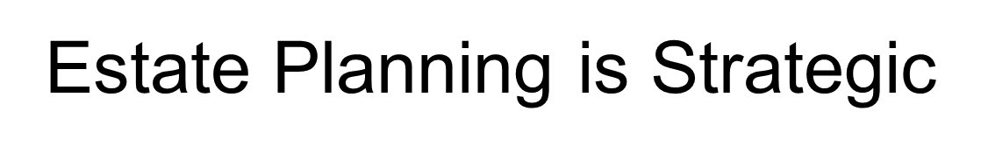

Will
or Trust
Durable Powers
Of Attorney
Financial/Health
Who carries out
the Plan?
Estate Tax
Planning
Titling and TOD
Coordinated
Directive to
Physicians

Slide 5

What is the best “vehicle” to administer my estate?

Slide 6
Option #1 : Do Nothing, or “INTESTACY”
Statutes give property titled in your name to your closest relatives
May pass property to unintended beneficiaries; not those you would choose
Problems if you have minor children
Requires probate

Slide 7
Probate
Probate is a court process needed when deceased’s name is on an account or property:
  File Will & open probate
  Obtain “letters testamentary”
  Notice to creditors
  Inventory of all assets
  Sell assets
  Pay off estate’s debts & costs
  Distribute assets to beneficiaries
  Receipts from beneficiaries
  Request probate be closed
  Closing probate

Slide 8

Probate
Probate = Time + Effort + $$ + Public

Slide 9

Option #2 : Titling
Many people make costly titling mistakes trying to avoid probate
Tenants in Common
Joint Tenants with Right of Survivorship
Beneficiary Designation

Slide 10
Option #3 : Community Property Agreements
A CPA is a contract between spouses giving all of the assets to survivor when the first one dies.
  Eliminates probate on the first death: SIMPLE!
  You still need a Will
  Washington CPA valid in Washington only
  Not appropriate if you don’t want all to go to the survivor
  Don’t do “I love you” Wills if your estate is over $2,000,000

Slide 11
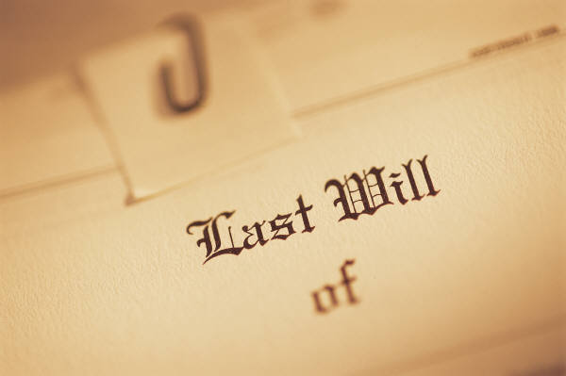
Option #4 : Wills
Your Will determines who your beneficiaries are
Wills avoid a mess but won’t avoid a probate!
Wills won’t protect you if you become incapacitated

Slide 12
WILLS AND Probate
Factors in judging whether you want to avoid probate:
  How well is your Will drafted?
  How complex are your assets?
  Where are the real property assets?
  How large is your estate?
  Do you have stinky relatives?
  Who is the attorney?

Slide 13
Option #5 : Revocable Living Trusts
Living Trusts are an alternative to Wills and Probate
  A Trust is a legal entity that continues through death until your estate is distributed
  Trusts have a Trustor, a Trustee, and beneficiaries
  Your Trust contains the distribution provisions that would normally be in your Will

Slide 14
Living Trusts
You retain the same control over your assets as before
You can amend or revoke the Trust at any time
No additional record-keeping or tax returns are required

Slide 15
Living Trusts
Your successor Trustee fulfills the duties of an executor, but without the courts and extensive attorney involvement
Critical that Trust is “fully funded” (all assets that are probatable are titled in the name of, or beneficiary to, your Trust) in order to avoid Probate

Slide 16

Pro’s and Con’s of Living Trusts
Pro’s:
  Privatizes the estate administration process
  Provides predictability in fees and hassle
  Provides incapacity protection
  Keeps estate organized
Con’s
  Higher up-front costs
  More work to set up (funding)
  Must put new assets in Trust or will have Probate

Slide 17
When is a Living Trust Appropriate?
Avoid the hassle and time delays involved in a Probate, and have family members settle the estate instead of an attorney
When Probate will be costlier than a Trust
Whenever there will be two or more Probates (e.g., real estate in other states)

Slide 18

“Have I properly planned for the beneficiaries of my estate?”

Slide 19

PLANNING for SURVIVING Spouse
“I Love You, Honey” Planning
  Deceased’s side goes to Spouse
  In Washington, use a Community Property Agreement
  No protections from Predators, Creditors, and Estate Taxes
  No Beneficiary Protection
“I Love You, Honey … But” Planning
  Deceased’s side goes to a Trust for Spouse
  Income + Principal if needed
  Protection from Predators, Creditors, and Estate Taxes
  Beneficiary Protection

Slide 20
The “Tax-Wise” Will or Trust
Estate Value: $4,000,000
Ward’s Assets:
$2,000,000
June’s Assets:
$2,000,000
Both
Alive
Spouse is Trustee
Family
Trust
Survivor
Spouse receives
all Income and
Principal as necessary
Protected from creditors and predators

Slide 21

Planning FOR CHILDREN AND GRANDCHILDREN
Minors
  Guardian provisions
  Testamentary trusts
Manners
  Irresponsible Children
  Incentive Trusts
Minders
  Special Needs Trusts
  Dynasty Trusts

Slide 22
Is Your Planning Up To Date?
2018 Tax Cuts and Jobs Relief Act (Estate Tax & Sunset)
2017 Power of Attorney Act (Powers of Attorney)
2012 Washington Trust Act (trust requirements)
HIPAA (Health Care Powers of Attorney)
Changes in Desires, Assets, Family and Friends

Slide 23

Resources
Get Your Ducks in A Row, Harry Margolis
Estate Planning Smarts by Deborah Jacobs
JK Lasser’s New Rules for Estate and Tax Planning by Stewart H. Welch III and J. Winston Busby
https://www.youtube.com/watch?v=V11IcRNrVSs
rehberglaw.com

Slide 24

Get Started
Only put off tomorrow what you are willing to die having left undone.
- Pablo Picasso
Rehberg law group, PLLC
Phone: (206) 246-8772
Toll Free: (877) 246-8772
Email: contact@rehberglaw.com Website: rehberglaw.com

